Slide 1
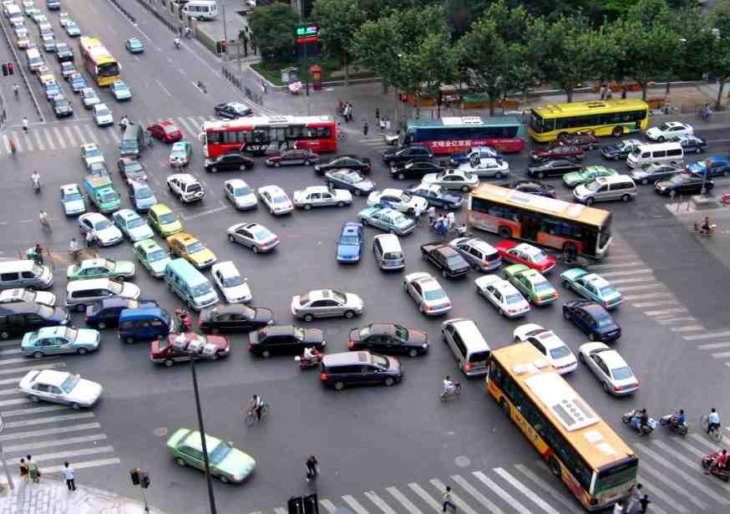
It’s complicated….

Slide 2
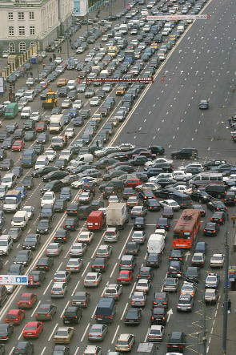
It’s complicated….
or perhaps it’s just complex

Slide 3
The formation of human trails

Slide 4
The formation of human trails

Slide 5
The formation of human trails

Slide 6
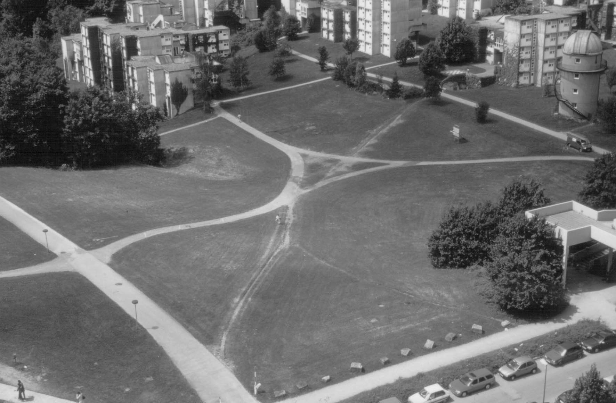
The formation of human trails
D. Helbing et al., Nature 388, 47 (1997)

Slide 7
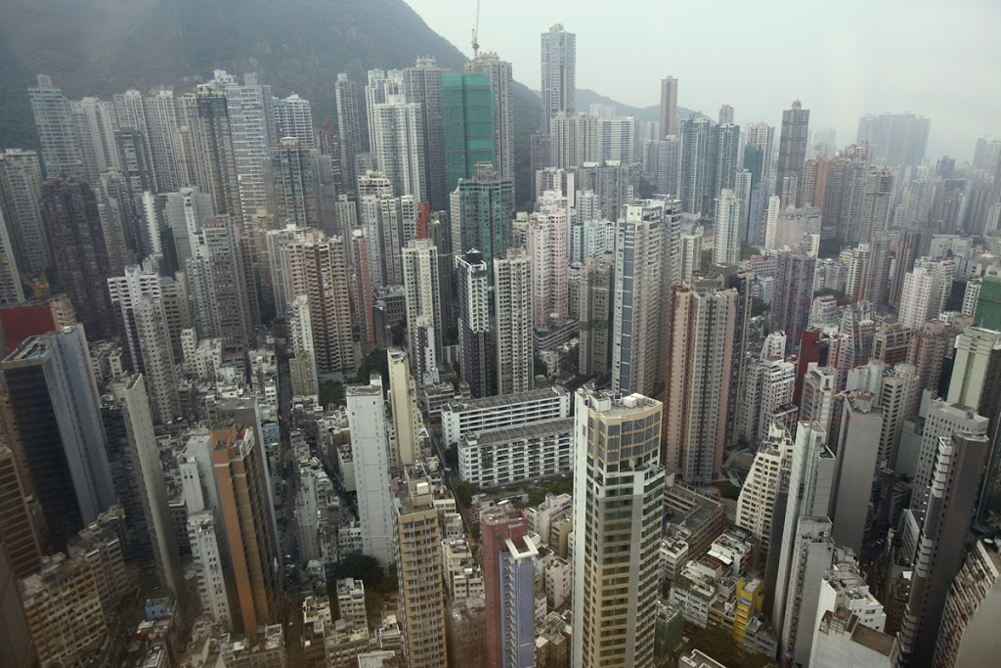
Understanding cities

Slide 8
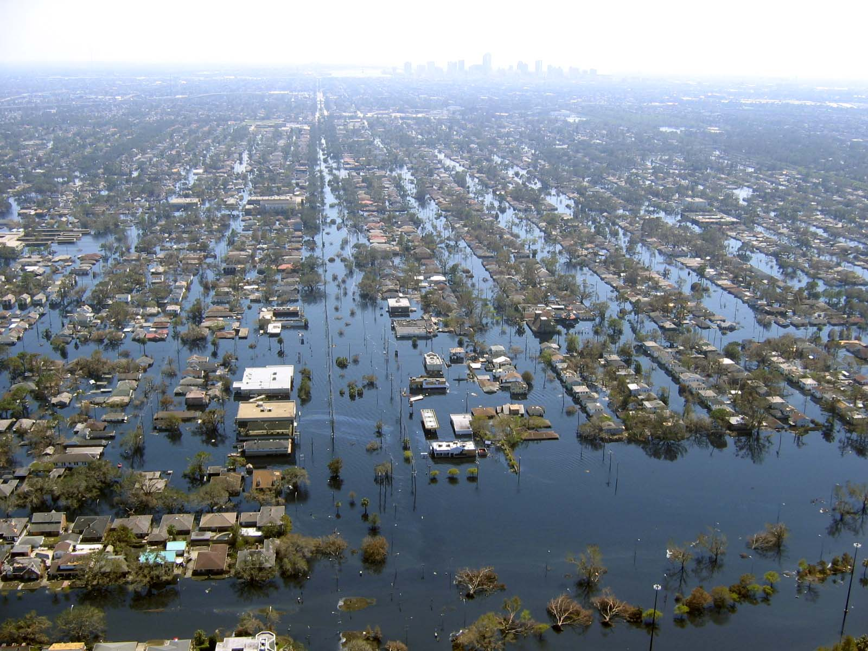
Understanding cities

Slide 9
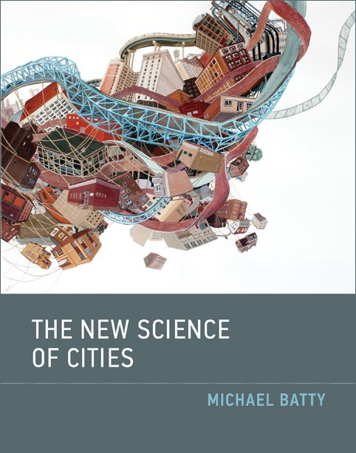
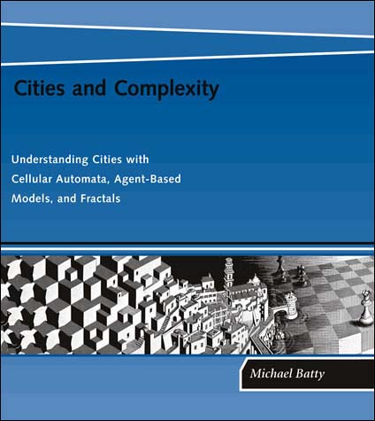

Slide 10
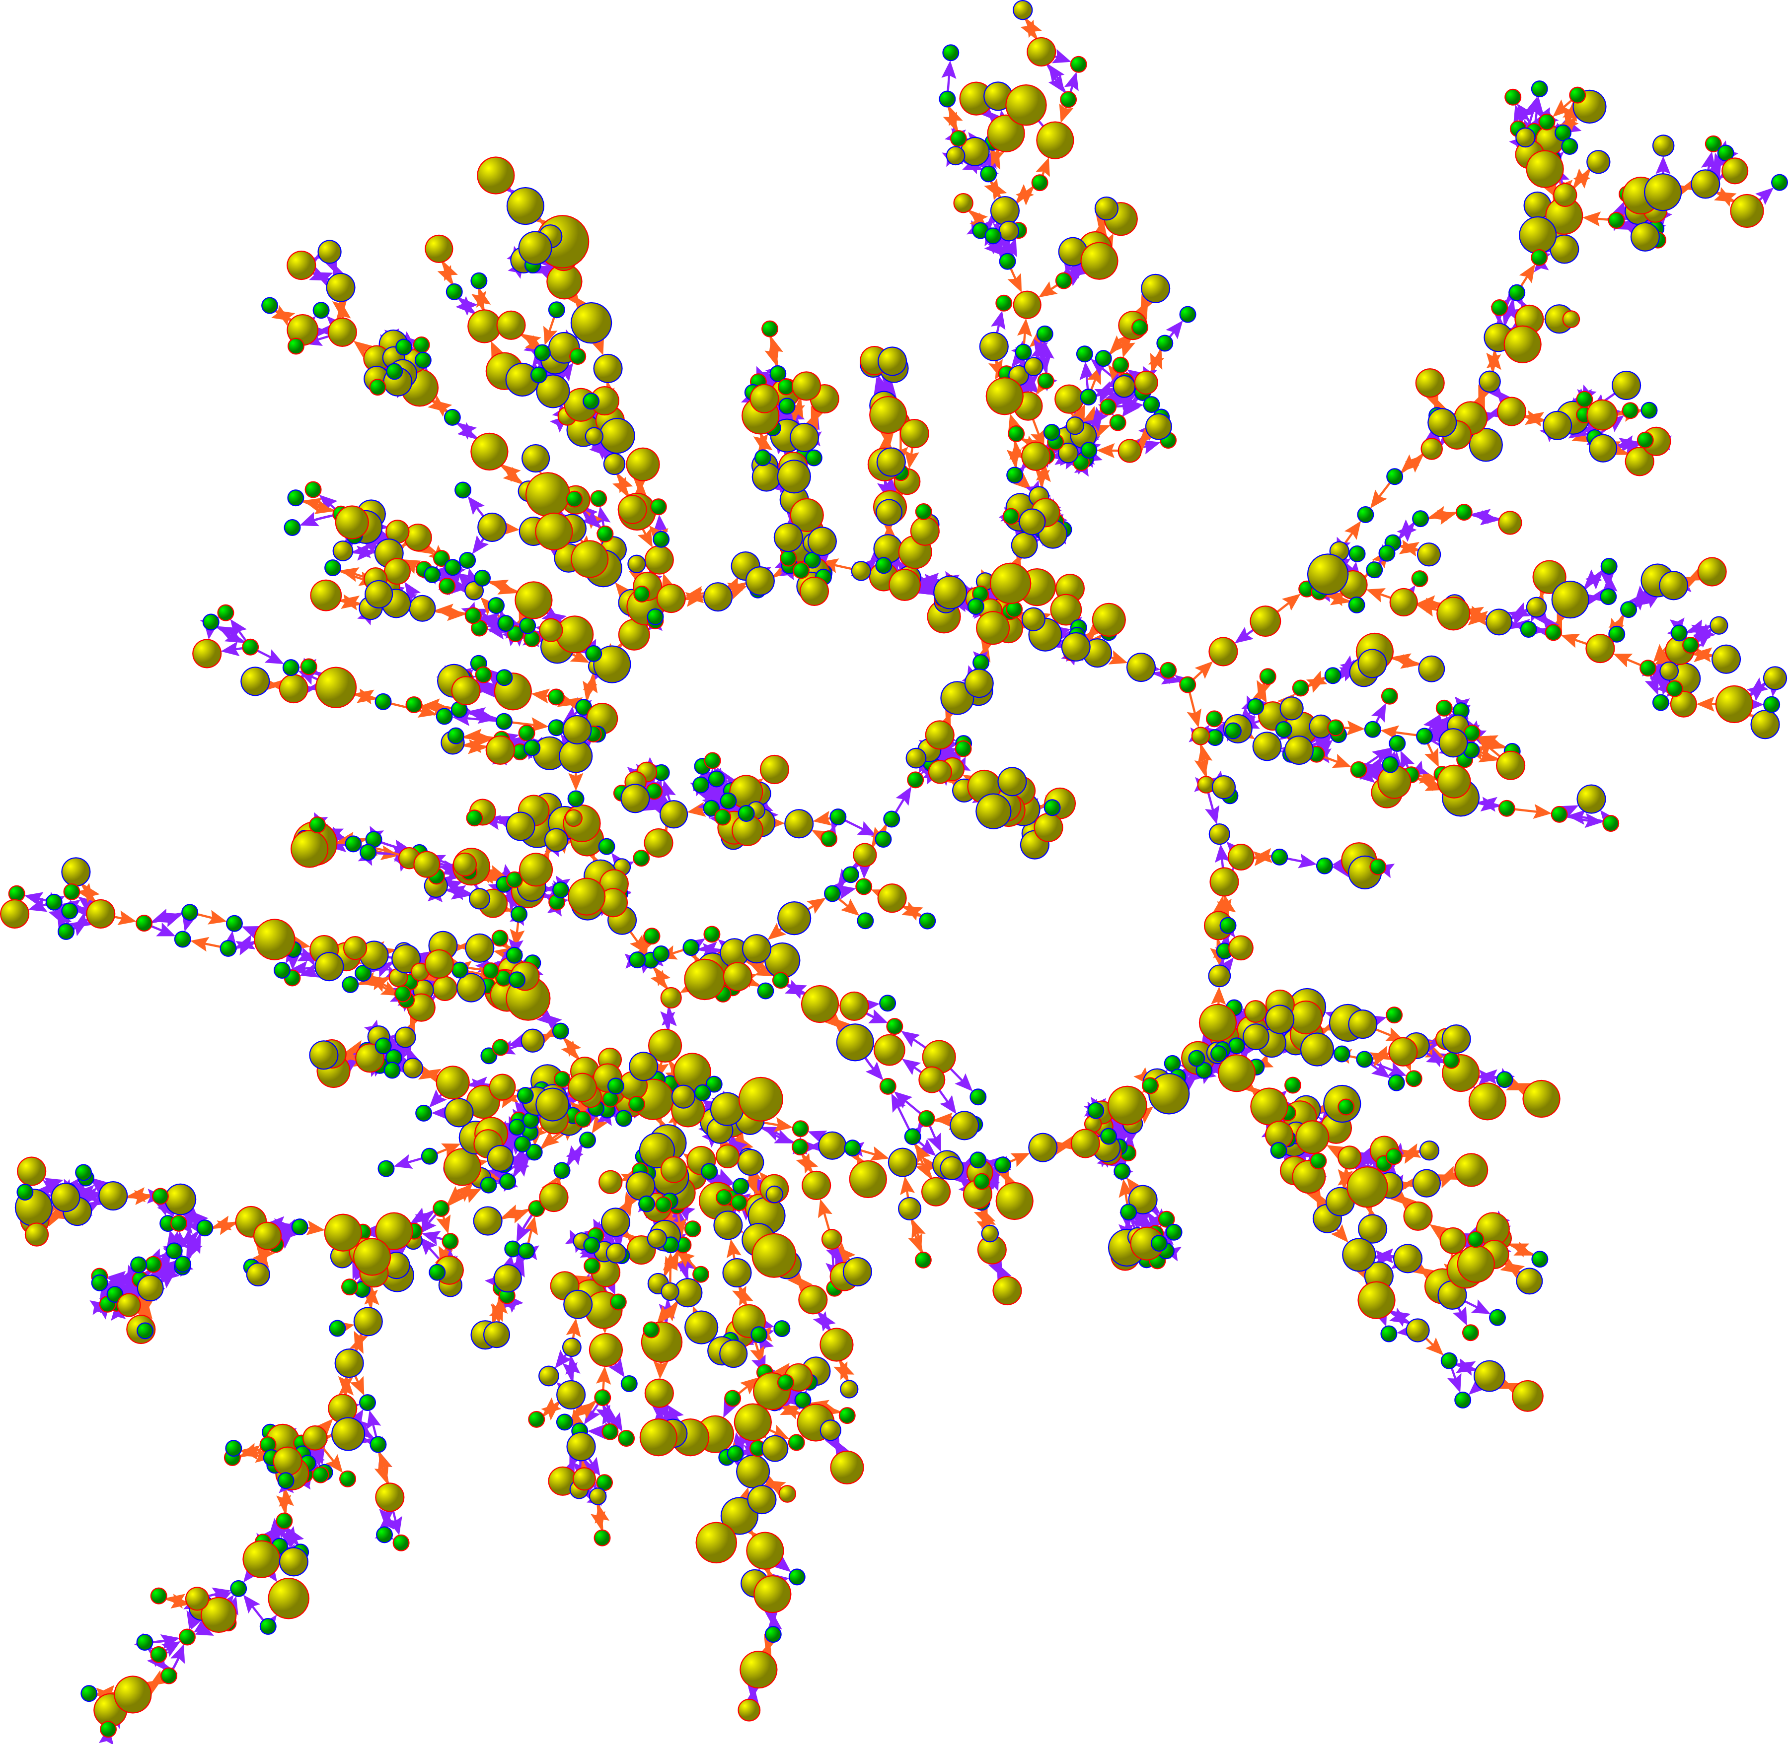
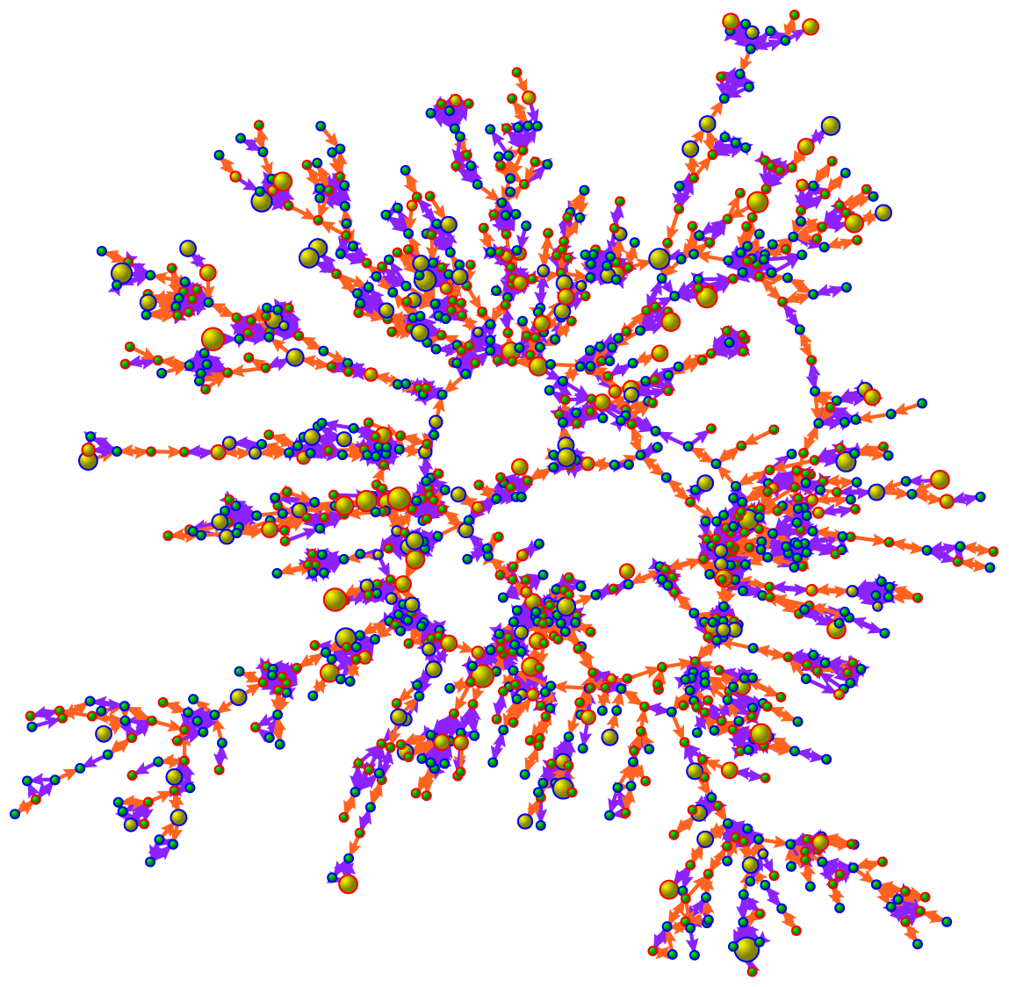
Social contagion
1971
2000
Christakis & Fowler, New Engl. J. Med. 358, 2249 (2008)

