Slide 1
Capturing the impact of research: lessons from the SHHEP initiative
Dr. Sally Theobald, SHHEP and REBUILD RPC

Slide 2




The SHHEP initiative
ABBA RPC
http://www.health-policy-systems.com/supplements/9/S1

Slide 3
Supplement foreword
The work reported in this supplement provides examples of approaches that have been tried and from which
other researchers can learn. They demonstrate that getting research into policy and practice is complex, dynamic
and multi-faceted; and a wide range of context and issue specific conceptual and practical approaches have to be
used. I hope that the innovative approaches and promising ways forward, presented in these papers, will inspire
and motivate others.
Professor Christopher Whitty & Dr Sue Kinn

Slide 4
Questions for the special issue
How do SRH and HIV/AIDS research organisations describe their policy influencing aims, and who are the policy makers they seek to influence?
What influencing strategies and approaches are used by SRH, HIV and AIDS research organisations and how are these shaped by methodology, context and subject area?
What are the different ways in which research evidence is strategically framed in order to maximise impact?
What strategies do research organisations use to track the impact of their work?
From the perspective of research organisations, what models and conceptual frameworks are helpful?

Slide 5
Organised into five themes
Theme
one
Theme
two
Theme
three
Theme
four
Theme
five
Theory
and
practice of research engagement
Applying policy analysis to explore role of research evidence
Strategies
and methodologies for
engagement
Advocacy and engagement to influence attitudes
Institutional approaches to intersectoral engagement for action and strengthening communications
Notes:
Theme 1: The theory and practice of research engagement
Theme 2: Applying policy analysis to explore the role of research evidence in SRH and HIV/AIDS policy
Theme 3: Strategies and methodologies for engagement
Theme 4: Advocacy and engagement to influence attitudes on controversial elements of sexual health
Theme 5: Institutional approaches to intersectoral engagement for action and strengthening research communications.

Slide 6
Literature on research to policy fast growing
ODI RAPID
IDRC
ESRC
WHO
HRSA
Less common is reflection from researchers or
research-funding organisations themselves about the
ideal roles of research organisations, about the compatibility between research and communications objectives, and about some of the tensions and challenges involved in policy influencing.
Notes:
Health Research Systems Analysis (HRSA) Initiative

Slide 7
Categorising research impact
Young and Mendizabal model
Discursive changes
Content changes
Procedural changes
Behavioural changes
Change discourse
Change
laws / policies
Change how stakeholders analyse their data on service delivery or GL
Raised awareness, attitudinal, building national capacity for research
Notes:
Discursive changes – change discourse – Opening new public spaces/discourses on representations of sexuality in Bangladesh (Rashid et al [11])
Challenging key academic or policy discourses, for example on health economics and on Children and HIV, and gender and masculinities (Crichton and Theobald [3])
Content changes – change laws / policies - Change in law to exempt survivors of gender-based violence from paying medical costs (Tulloch et al [9])
Research to analyse the process of uptake of Cotrimoxazole preventive therapy in Zambia, Uganda and Malawi and draw out lessons on policy change (Hutchinson et al [5])
Procedural – change how health related gov ministries or agencies analyse their data on service delivery - Gender disaggregated data and equity analysis of ART data now part of MoH processes (REACH Trust, Malawi) (Crichton and Theobald [3])
Behavioural – Raise awareness of and access to research and capacity to understand it - Media engagement and media capacity building:
Raising awareness about health and rights through an entertaining and engaging drama – Makutano Junction (Oronje et al [6])
Support attitudinal change - The Pleasure Project’s global mapping of pleasure used research to promote sexy safe sex (Knerr & Philpott [12])
Building national capacity to carry out research and identify the policy implications - Research was undertaken on OVC within the Ministry of Health and links developed with other government departments (Gyapong et al [13])

Slide 8
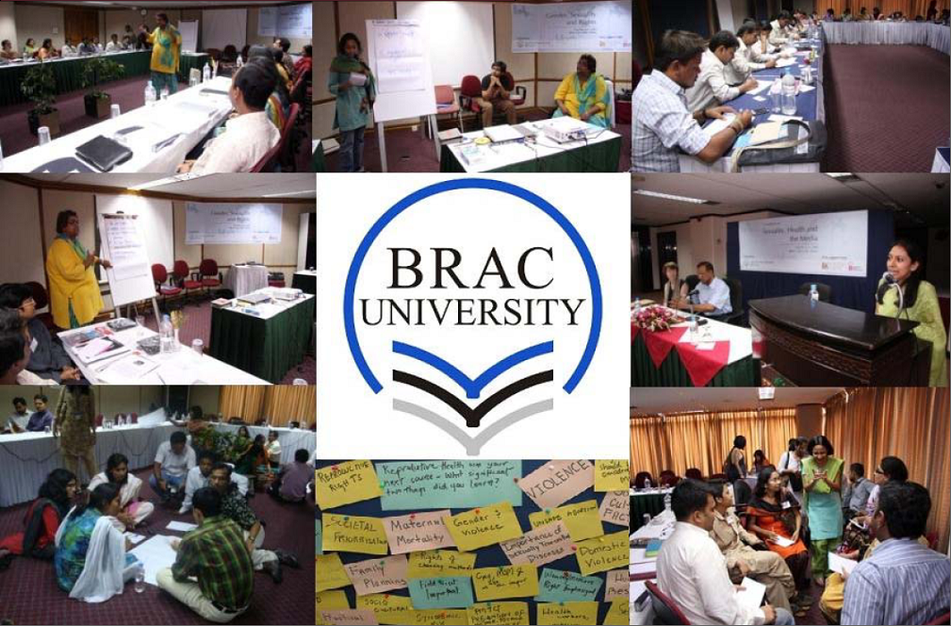
Change discourse

Slide 9
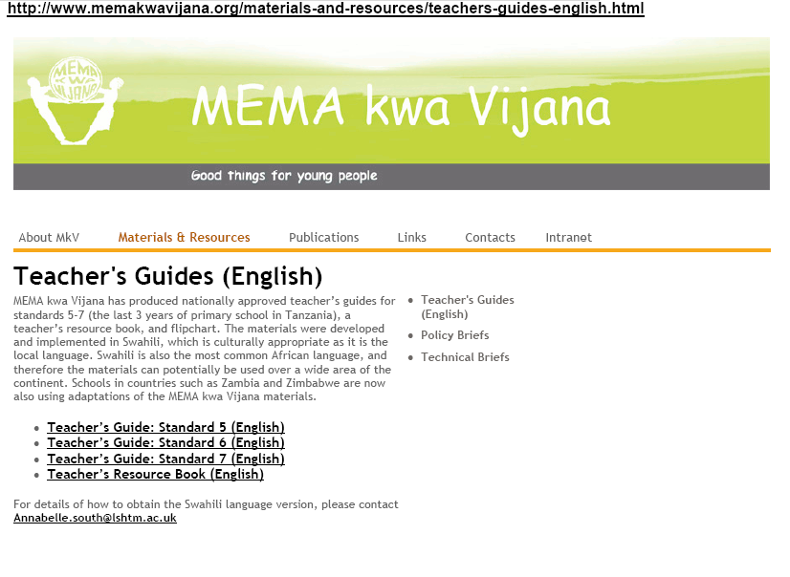
Change guidelines/develop new guidelines

Slide 10
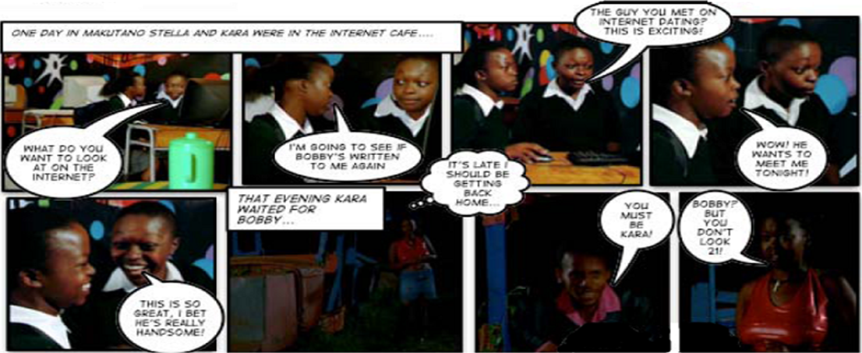
Raise awareness of research and support attitudinal change
Extracts from information resources to raise awareness about rape, reduce stigma and inform Makutano Junction viewers about post-rape care services.

Slide 11
Learning from the SHHEP process
Investing in communications and research uptake matters...
Undertaking reflective assessments of the policy relevance of research evidence, its scope and limitations within a particular context and the ethical implications of communicating the research
Carrying out strategic scoping of opportunities and levers for influence through analysis of the policy context, actors and processes, including the political or cultural acceptability of research approaches and findings within context and throughout the research cycle ‘embedded’
Assessing the nature of the research evidence and consulting with other key actors on how best to frame it in ways that increase local decision makers’ receptivity.
Keeping ccommunications strategies flexible, innovative, jargon free and relevant to research institutions’ objectives to keep them effective.
Being aware of the broad range of research impacts and multiple approaches to capturing impact
Notes:
Tie to health systems research

Slide 12
Networking and coalitions
Complex approaches
Different institutions forging partnerships
Embedded, connected, forging relationships
Paradigm shift away from dissemination to ongoing partnerships
“If you do [research] in partnership with government they easily accept the findings and take it up. […] if they were our partners from the very beginning of that project then they would easily believe its credible.”
(Communications Officer, Kenya)
Notes:
Working with the media

Slide 13
NEW OPPORTUNITIES PROVIDED BY THE REF
Research Exercise Framework – 2013
A key change from the 2008 Research Assessment Exercise (the predecessor of the REF) is the need to develop case studies on research impact
Debates and discussion - How will impact be measured and assessed
Unintended consequences?

Slide 14
Position and skills of research actors
Diversity in characteristics, actions and organisational approach
“You know many good researchers don’t make good advocates. Quite a different skill and I think that's very rarely recognised. A good academic is trained to […] state the […] cautions, the doubts, whereas those are fatal qualities for an advocate who has to simplify, dramatise, exaggerate.”
(Researcher, UK)
‘‘I’m pushy and I think of everything as an opportunity and I don’t shut doors and I keep resisting […] I am always looking for ways [for there to be] something more than just research in a book. Because […] I work a lot with poverty and urban poverty and especially […] in urban slums, I think [in terms] of the rights perspective or the structural inequalities for poor people.”
(Researcher, Bangladesh)

