Slide 1
The State of Evidence in Global Education
SCALE
MACRO
RESEARCH GAP
DFID RESEARCH OPPORTUNITY: LEARNING, SCALE
& LEVELS
Fragmented
Predominantly Primary
Problem identification
Fragmented
Predominantly Primary
Problem identification
Inputs Accountability Access
Primary
MICRO
Size of text box represents size of evidence base
Text describes focus of research, Stars represent quality:
*****: high
*: low
QUALITATIVE
MIXED
QUANTITATIVE
METHODS

Slide 2
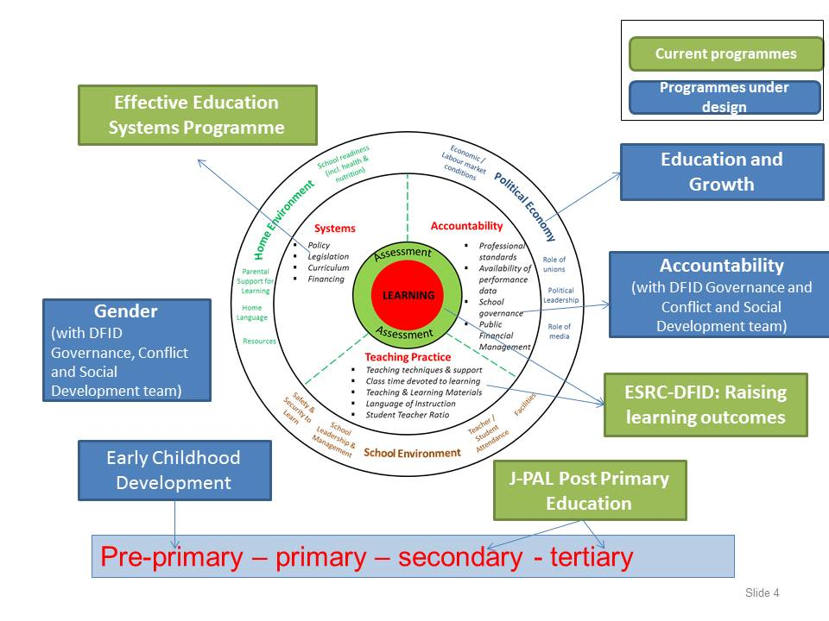
Education Research Portfolio
Delivery

Slide 3
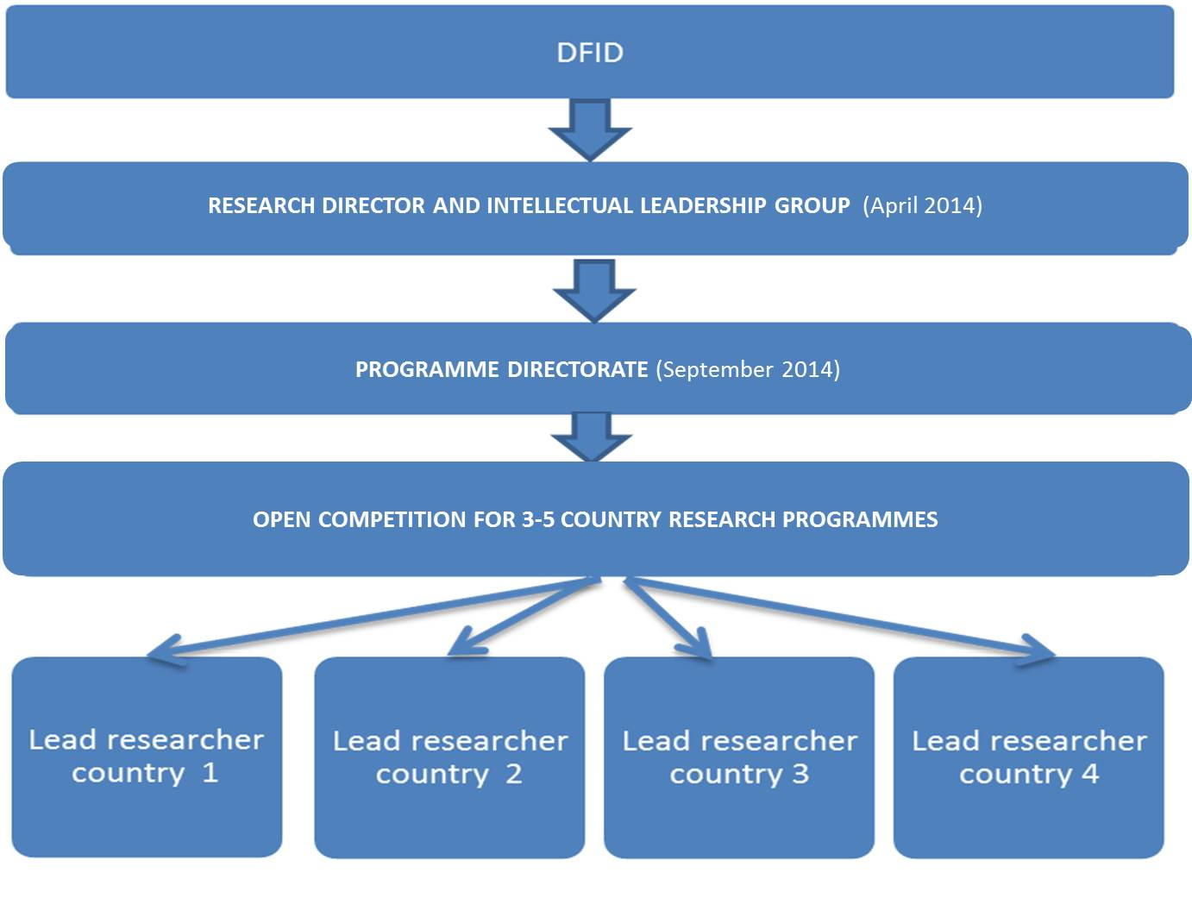
Effective Education Systems: Programme structure

