Slide 1






Involving
End
Users
Oliver Cumming
London School of Hygiene and Tropical Medicine
SHARE Consortium

Slide 2
Key points
Context and overview
Our end-users
Case studies
Reflections
In 10 minutes!

Slide 3
Context
Context
2.5 billion people without access to safe sanitation
1.0 billion people defecating in the open

Slide 4
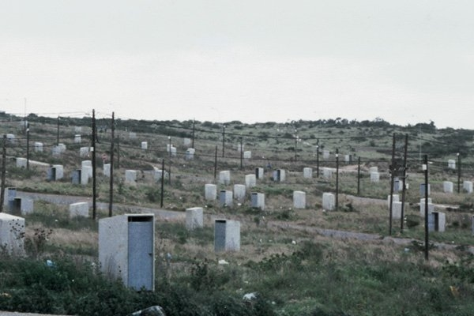
… and even toilets without people.

Slide 5
Our contribution
5 partners – researchers and implementers
£10 million for 2010 – 2015
Two regions; four focus countries
‘Rigorous & relevant research’ to make sector investments more effective, more equitable and sustainable

Slide 6
SHARE objectives
Undertake a range of activities to:
Characterise problems so others can address them
Identify solutions so others can adopt them
Demonstrate benefits to ensure adequate prioritisation by others

Slide 7
The ‘others’
What we understand by end-users:
  Those who have power or influence to shift sector investment towards greater equity, safety, sustainability
  Term these actors as boundary partners – situated at the boundary between us and the outcomes we want to see
  Main actors: national and local government, bilateral and multilateral international agencies, global and national practitioners

Slide 8
Involving end-users
How and when do we involve them:
  Consortium members
  Identifying research priorities
  Developing research questions and protocols
  Interpretation of findings (not analysis!)
  Communication/dissemination of our results

Slide 9
Case study(ies)
3 (1 slide only) case studies highlighting different approaches to involving end-users:
Global policy actors
National government and other sector actors
Global community of practice

Slide 10

1. Cochrane review for the effect of WASH on childhood undernutrition
1. Barrier
WASH is a potentially important but over-looked contributing factor to childhood undernutrition
2. End-users
Global policy actors from development, nutrition and WASH sectors
3. Strategy
Rigorous review of evidence base conducted by nutritionists with advisory panel including key end-users, convening activities around protocol, advance commitment from users to utilise findings in policy
4. Result
Early days but… basis for a number of significant policy guideline documents, basis for new research activities, new policy questions (how not why)

Slide 11
2. SHARE India Research Platform
Barrier
(1) Research uptake in WASH sector; (2) current level and nature of investment in sanitation in India does not reflect differential effects on women and girls
2. End-users
Federal and priority state-level policy for TSC and urban programmes
3. Strategy
Research platform – including federal line ministry Director - to identify questions, refined by a cross-sectoral/disciplinary group
4. Results
Consensus on question/approach (!), collaboration across sectors/disciplines, government + participation, commitment of pro bono time/resources

Slide 12

3. Menstrual Hygiene Management Guidelines
Barrier
No current guidelines or resource book on best practice for menstrual hygiene management limiting programmatic priority and uptake of an important issue for girls & women
2. End-users
Global and national practitioners and donor agencies; national government; led by an ‘end-user’
3. Strategy
Process, process, process…. broad consultation and participation at every stage; co-publication of non-branded guidelines; linked to high-level processes (post-2015, Human Right to Water & Sanitation)
4. Results – Guidelines peer-reviewed by 10+ academics, reviewed and co-published by 20+ international NGOs, UN agencies, government donors; active incorporation of guidelines at the review stage

Slide 13
Reflections
Research (alone) doesn’t change the world, end-users do…
The right evidence at the right time
Interpretative capacity deficit at all levels
Need people who can bridge – ‘rigour & relevance’
Beyond communications - interpretation and adaptation

Slide 14

Reflections
Retro-active research uptake
Hierarchies of ‘evidence’ – you might not need an RCT
Publication and political cycles rarely coincide so be ready
Big problems rarely have simple solutions but policy-makers and politicians still want them!

Slide 15
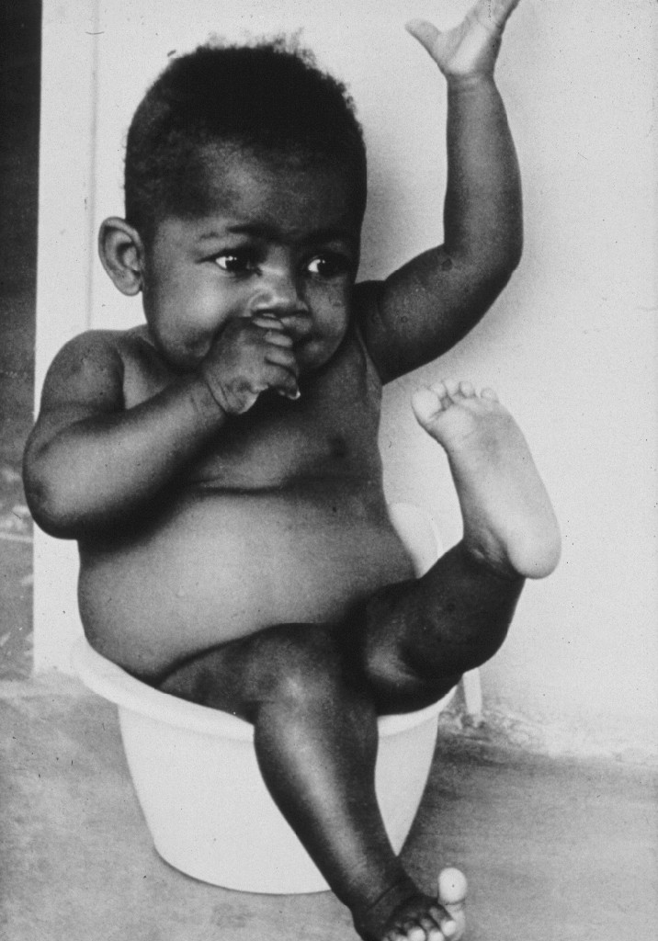
Thank you
www.SHAREresearch.org
oliver.cumming@lshtm.ac.uk

