Slide 1
Is focussing on Research Impact Bad for international development?
Kirsty Newman
DFID

Slide 3
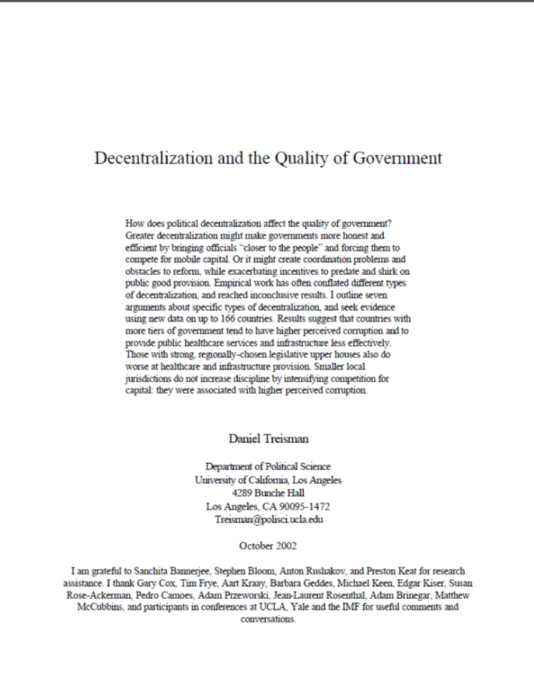
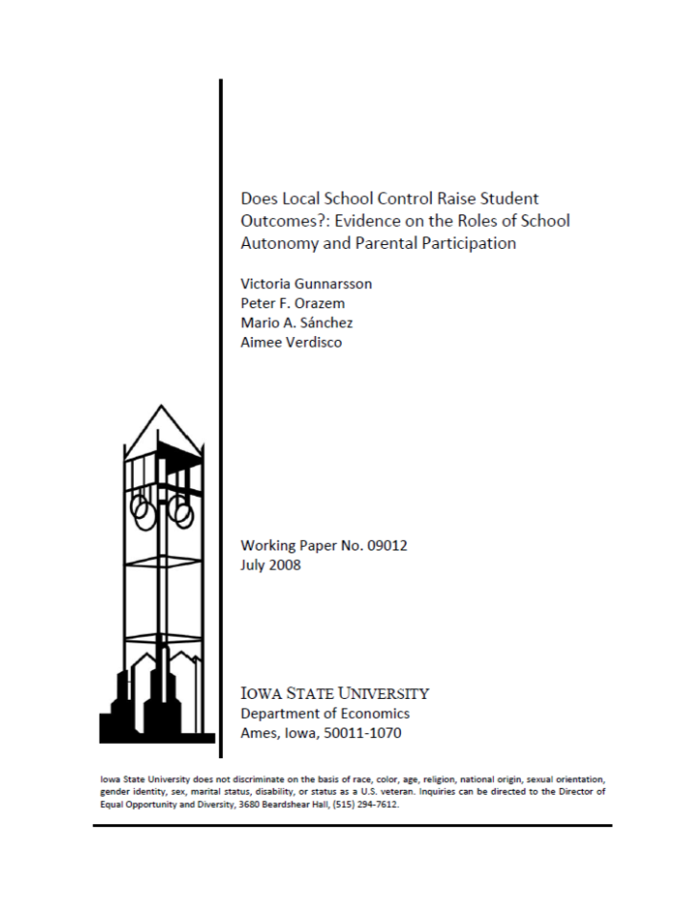
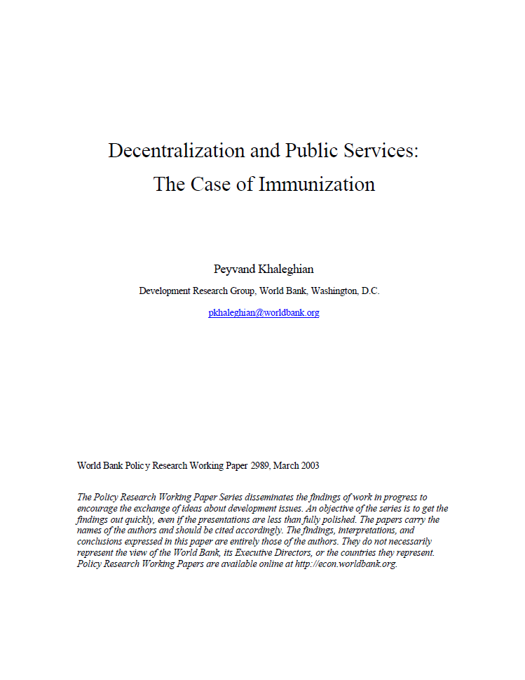
Is decentralisation good for public service provision?

Slide 4
HIV Treatment

Slide 5
MP-Scientist Pairing Scheme

Slide 6
Kirsty’s rules on impact
Use research to answer the important questions
Use the best methods available
Publish in open access format and ensure key audiences are aware of emerging findings
Support synthesis of findings
Build capacity, systems and incentives to USE research

Slide 8
A compromise?
To achieve impact
Use research to answer the important questions
Use the best methods available
Set clear guidelines on advocacy and lobbying
Encourage researchers communicate their findings in the context of the body of evidence
Support synthesis of findings
Build capacity to access, evaluate and use research
To measure impact
Consider impact embodied in people
Use episode studies to track back from key decisions/paradigm shifts

