Slide 1
Health Systems Research: History and Evolution
Kara Hanson
Department of Global Health and Development
Improving health worldwide
www.lshtm.ac.uk

Slide 2
Outline
1. Origins and evolution of health systems research
2. What is HPSR – methods and models
3. Recent methodological developments
4. Key challenges

Slide 3
Evolution of thinking about health systems
Global Fund
For AIDS, TB,
Malaria (2002)
WB Investing in
Health (1993)
Disease control
programmes
(Malaria,
“Grandes
endemies”)
“New public
Management”
Health systems
facility
2000 World Health
Report
Health systems
Alma Ata
PHC (1978)
Selective PHC
1960
1980
2000
2020
Recognition of
system
underpinnings
World Bank
Agenda for
Reform (1987)
Commission on
Macroeconomics
and Health (2001)
Post-2015
development
goals
Global Alliance for
Vaccines and
Immunisation (2001)
Health systems
Strengthening
Funding (2005)
Notes:
Theme – pendulum of HS vs. disease-driven programmes
Major expansion in the MDG period – recognition that diseas-specific targets could not be met with weak systems.

Slide 4
From disease-specific to system-level questions
Constraint | Disease-specific response | Health system response
Financial inaccessibility, inability to pay, informal fees | Exemptions, reduced prices for focal diseases | Development of risk-pooling strategies
Physical inaccessibility: distance to facility | Outreach for focal diseases | Reconsideration of long term plan for infrastructure development and siting of facilities
Inappropriately skilled staff | Continuous education and training workshops to develop skills in focal diseases | Review of pre-service training curricula to ensure appropriate skills included in basic training
Poorly motivated staff | Financial incentives to delivery priority services | Institution of performance management systems, clarifying roles and expectations, strengthened supervision, review of performance management, salary structures
Adapted from Travis et al. Lancet 2004
Notes:
Example of how health systems thinking has informed debates about how to address disease-specific challenges; and points to a research agenda that addresses the underlying health system

Slide 5
Development of HSR as a field
WHO Taskforce
For HSR 2004
Intl conference on
health research
for devt (2000)
Health Systems
Global (2012)
“Belgian school”
Kasongo,
Bwamanda
Alliance for
HPSR (1998)
1st (2010) and
2nd (2012)Global
Symposia on HSR
National health
expenditure
surveys
WHO Ad Hoc Cttee on
Health Research (1996)
Decentralisation
1960
1980
2000
2020
DFID
HEFP (1990-4)
DFID
HSD
Programme
(2000-2005)
Good Health at
Low Cost (2012)
Public-
Private mix
Network
RESYST (2011-16):
Rural healthworker
retention; purchasing;
accountability structures
and reforms
Equity effects of
user fees
Contracting
Notes:
Not new – carried on without “label”; eg. Belgians (+ others) at Antwerp – clinical, but recognition of need for systems support – CBHI, district hospitals
Background of well-established methods in “health services research”, eg. NHS, from 1990s
Anne Mills’ review – Casual google scholar search in May 2008 finds little on “HSR” or “HPSR” - (LSHTM bias)

Slide 6
Health policy and systems research
...production of new knowledge ...to improve how societies organize themselves to achieving collective health goals, and how different actors interact in the policy and implementation processes to contribute to policy outcomes.
... interdisciplinary, a blend of economics, sociology, anthropology, political science, public health and epidemiology that together draw a comprehensive picture of how health systems respond and adapt to health policies, and how health policies can shape − and be shaped by − health systems and the broader determinants of health.
(Alliance for Health Policy and Systems Research, 2011.)
...Encompasses “research ON policy” and “research FOR policy”
Notes:
A topic, not a discipline;

Slide 7
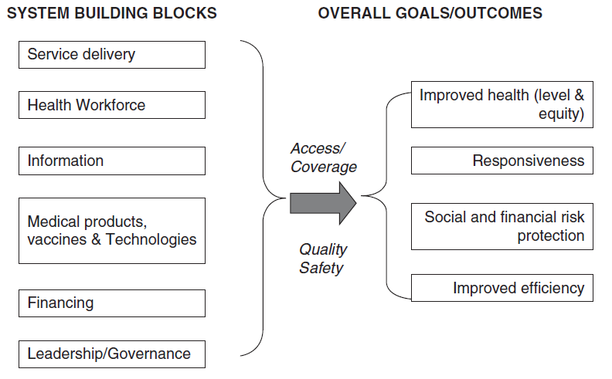
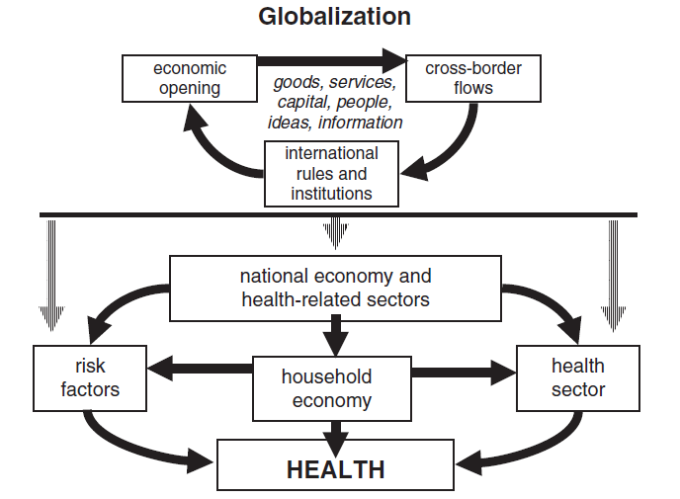
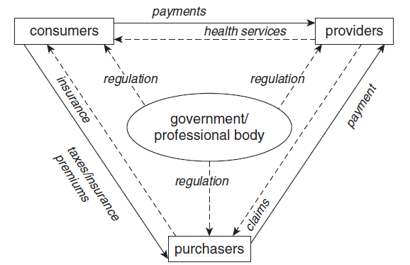
Guided by a variety of health system models
Sources: Gilson 2011 (WHO models);
Smith and Hanson 2011.
Notes:
Blocks ; Relationships ; recognise influences outside the “health sector”

Slide 8
Driven by questions
 | Macro: Architecture and oversight of systems | Meso: Functioning of organisations and interventions | Micro: Individual in the system
Evaluative | Does a new financing mechanism protect the poorest households from catastrophic costs? | What are the reasons for low uptake of community-based health insurance? | What financial and non-financial incentives will encourage health workers to locate in underserved areas?
Exploratory / Explanatory | Why do informal health markets continue to flourish where publicly provided services are adequate? | How do pay-for-performance arrangements interact with local accountability structures? | Why do frontline health workers prescribe antimalarials to patients with a negative test?
Adapted from Sheikh et al. PLoS Medicine 2011
Notes:
Fundamentally a field driven by questions; useful way to think of these is to distinguish – Evaluative from descriptive / exploratory/explanatory; and the level of enquiry

Slide 9
Recent methodological developments in HPSR
“Systems thinking” – Recognizing complexity and interaction
Advances in (non-experimental) impact evaluation –
Theory-based evaluation
Evaluation of complex interventions

Slide 10
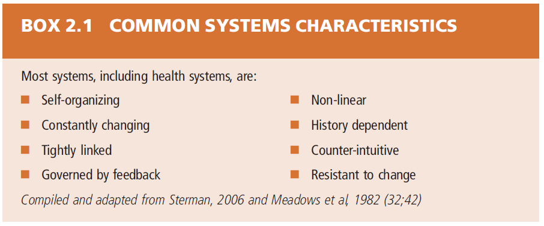
Notes:
Motivated by practical questions – why do interventions or policies or reforms not have their desired effects? Possibly because our models and tools are too simplistic, fail to recognise the complex and adaptive nature of systems; broadening field of research to include, eg, systems dynamic modelling to simulate systems behaviour and response – to test hypotheses, gnerate scenarios.

Slide 11
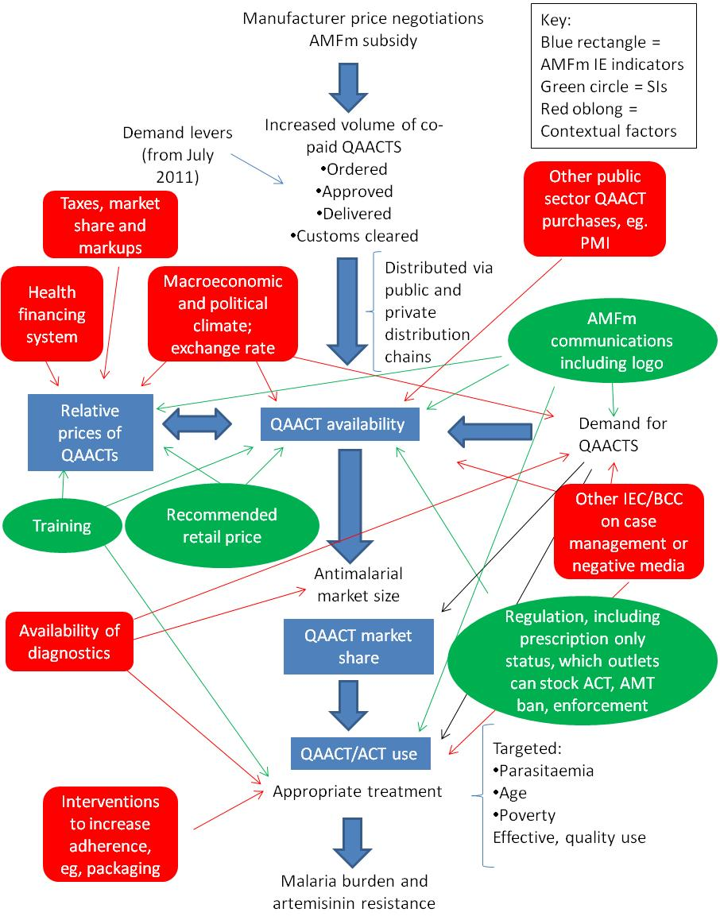
Evaluating complex interventions
Number of and interaction between components
Number of and difficulty of behaviours required by those receiving the intervention
Number of groups / organisational levels targeted by the intervention
Number and variability of outcomes
Degree of flexibility/tailoring of intervention permitted
Source: MRC Guidance for
Evaluating Complex Interventions
Theoretical understanding
Process evaluation
Unintended consequences
Notes:
Closely related to second point – contributions to methods for evaluation
Here interested in evaluation of health system interventions – interventions aimed at one or more of the “building blocks” – typical example is pay-for-performance schemes

Slide 12
Key Challenges in HPSR
Building capacity to undertake and use HPSR
Demonstrating rigour
Generalisability
Funding
Influencing policy and practice
Notes:
- HPSR taking place in a variety of institutional contexts in LMICs – research units linked to ministries of health (eg. IHPP); independent research institutes (IHI); within universities (in SPH or in academic departments like economics, where multidisciplinary nature not always appreciated); need to raise profile and status of HPSR as a field of academic endeavour, attract and retain good scholars.
- also need to address policymaker and programme manager skills to use research in their decision making; partly about how research is conducted; and how presented
Rigour – view among some that HPSR “isn’t science” – affects funding opportunities; linked to capacity issue; but also to need to recognise the wide variety of types of question that are the legitimate focus of HPSR, and apply relevant disciplinary standards – willingness to move beyond positivist frameworks for some questions, esp those which are exploratory, explanatory;
- Key challenge is generalisability – whether findings from one context can be transferred and applied in others. Strong need for comparative and x-country research; rigorous case studies.
- Funding – EU, DFID have been champions of research in this field; but still difficult to fund large scale programmes
- Influencing policy – partly about way research is conducted (how questions are arrived at, who is involved); packaging and presentation of results; partly about institutional structures for research uptake --- important challenge for research that seeks to inform policy.
Conclusion: exciting field; unprecedented growth; increasing credibility as a field, with own society and conference. But still a long way to go...

Slide 13
References
Mills A. 2011. Health policy and systems research: defining the terrain; identifying the methods. Health Policy and Planning.
Sheikh K et al. 2011. Building the field of health policy and systems research: framing the questions. PLoS Medicine 8(8).
Gilson L, ed. 2012. Health policy and systems research: A methodology reader. Geneva: Alliance for Health Policy and Systems Research.
Adam T and de Savigny D. 2009. Systems thinking. Alliance for Health Policy and Systems Research. Geneva.

