Slide 1
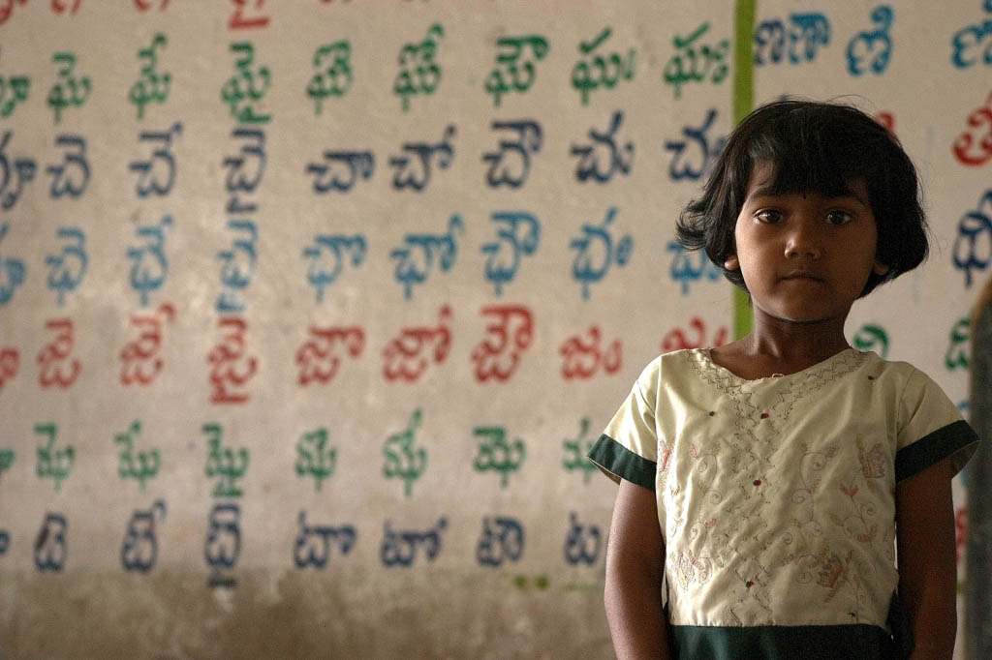

Education Systems Research in Developing Countries: Lessons from Young Lives
Caine Rolleston
Young Lives, University of Oxford
21st June 2013
Notes:
1

Slide 2

YOUNG LIVES’ SURVEY DESIGN
Baseline for school surveys - Young Lives longitudinal survey of children, households & communities every 3 years since 2002
    12,000 children
    Ethiopia, Peru, Vietnam, India
    20 sentinel sites in each country
    Qualitative component for a sub-sample
School surveys (from 2010)
    Focus on learning & learning progress
    School and teacher effectiveness
    Longitudinal (repeated measures) essential to better understand learning pathways
    Index children and their class peers sampled at school
    Rich linked data back to children’s birth

Slide 3
DO SCHOOLS MATTER AND FOR WHOM?
Despite a large number of studies of the effects of observable school inputs, little consistent evidence on ‘what works’ in terms of individual school inputs
the effects of most school and teacher characteristics are not statistically significant
the few that are “not particularly surprising and thus provide little guidance for future policies and programs” Glewwe et al (2011)
Yet there are large differences between and within systems on pupil achievement and school effectiveness (value-added to learning)
Complex interplay of ‘bundles of inputs’, system characteristics, political economy
Notes:
3
3

Slide 4
ALTHOUGH ENROLMENT IS HIGH IN ALL YL COUNTRIES THERE ARE LARGE DIFFERENCES IN LEARNING LEVELS BETWEEN SYSTEMS
Vietnam - pupils typically able to answer age-appropriate maths items
India - pupils master items at age 7-8, but dramatic drop-off by age 14-15
Pupils abilities remain in-line with the curriculum in Vietnam
Curriculum in India is progressively over-ambitious compared to actual progress

Slide 5
OVER TIME, A LARGE GAP OPENS UP BETWEEN PUPILS’ TEST SCORES IN INDIA AND VIETNAM
Site-level average maths score at age 7-8
Site-level average maths score at age 14-15

Slide 6
THERE ARE LARGE DIFFERENCES IN LEARNING PROGRESS OVER TIME BETWEEN SYSTEMS
Notes:
6
6

Slide 7
SCHOOL-SYSTEM QUALITY INDICATORS: INDIA AND VIETNAM
Indicator | Vietnam | India
Mean class size | 27.61 | 16.23
Mean years of teacher experience | 17.47 | 7.71
Mean monthly teacher salary (USD/Month) | 164 | 226
% of teachers with no formal teacher training qualification | 0% | 16.50%
Teacher absenteeism | 2.34 days per year | 35.12% pupils said ‘ my class teacher often does not come to school’
All children have access to maths textbooks | 96.16% | 60.84%
Teacher always checks/marks maths homework | 41.28% | 18.06%

Slide 8
TEACHERS IN VIETNAM KNOW WHAT PUPILS KNOW
(AND NEED TO KNOW)

Slide 9
A KEY CHALLENGE IN UNDERSTANDING EDUCATION SYSTEMS IS MEASURING SCHOOL QUALITY
Aim to measure the value-added by schools to pupils’ learning
Need to separate the effects of pupils’ backgrounds and prior attainment
Requires a longitudinal design (repeated test measures)
Requires linked data at teacher, school and pupil (background) levels
Requires repeated test measures that can be compared on a common scale
Example: value-added analysis in Vietnam produces different findings to cross-sectional research
 | Vietnamese 2011 | Vietnamese 2012 | Vietnamese Value-Added
Male | -20.3524 | -19.3315 | -12.6761
 | (-6.835)*** | (-6.538)*** | (-5.100)***
Ethnic minority | -17.6592 | -7.1008 | 0.2911
 | (-1.907)* | (-0.809) | (0.042)
Notes:
Yet, it is still possible that expenditures on basic school inputs, if properly directed, can play a role in improving students’ outcomes in developing countries

Slide 10
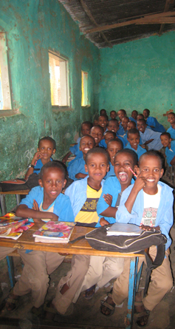
CONSTRUCTING LEARNING METRICS IS A PARTICULAR CHALLENGE (YL ETHIOPIA)
Challenge of low & variable literacy levels
Balancing national curricula/expectations and international norms in literacy & numeracy
8 linguistic groups/ languages of instruction challenge to compare across them requires test-item linking
Use of IRT techniques (as in TIMSS) to create common measures over-time and across languages
Tests with common items used at beginning and end of school year to measure progress
Notes:
10
10

Slide 11
SCHOOL-LEVELVALUE-ADDED (VIETNAM)
School Value-Added: Learning progress attributable to schools and teachers after removing prior attainment and background effects
  Which Schools Add More Value?
  Not more advantaged pupils
  Slightly better physical resources
  Not better teacher subject knowledge
  More permanent teachers
  More teachers with degrees
  More positive teacher attitudes e.g.
  “The influence of a student’s home experience can be overcome by good teaching”
  Teachers more often evaluated
Notes:
11
11

Slide 12
ARE SCHOOL SYSTEMS EQUALLY EFFECTIVE FOR ALL PUPILS?
Difference in effect on test scores of an increase in school quality (pupils from richest 40% of households compared to the remaining 60%)
In Vietnam, schools are equally effective in teaching Maths to children irrespective of backgrounds.
In Peru schools appear to be significantly less effective at teaching children from disadvantaged backgrounds
Notes:
I don’t know the level of statistical significance of Peru because

Slide 13
WHAT IS DIFFERENT ABOUT THE VIETNAMESE SYSTEM?
Equity-oriented centralised public school system
Less evidence that disadvantaged pupils attend lower quality schools
Less evidence that schools are less effective for disadvantaged pupils
High-performance for the majority linked to equity orientation
Emphasis on ‘fundamental’ or minimum school quality levels (especially in disadvantaged areas)
Common curricula & text books in use matched closely to pupils’ learning levels
Commitment to ‘mastery’ by all pupils - use of regular assessment by teachers
Teacher knowledge (YL curriculum tests) is similar between more and less disadvantaged areas, absenteeism is low across almost all schools

Slide 14
KEY MESSAGES
Adequate data and learning metrics are often not available
Measuring school quality requires robust longitudinal design
Theory of change
depends on the system too
  Centralised, authoritarian, technocratic (Vietnam)
  Federal, democratic, bureaucratic, pluralistic (India)
Largest differences
between systems (e.g. more than public vs private)
school quality varies very widely in heterogeneous systems
Context paramount

Slide 15



FINDING OUT MORE
caine.rolleston@qeh.ox.ac.uk
www.younglives.org.uk
Notes:
15
15

