Slide 1
Science to the rescue
Does public investment in science drive socioeconomic development?
Dr Kirsty Newman

Slide 2
“It’s not possible to take the country forward without having proper knowledge on science and technology” Sheikh Hasina, Prime Minister of Bangladesh
UN Photos

Slide 3
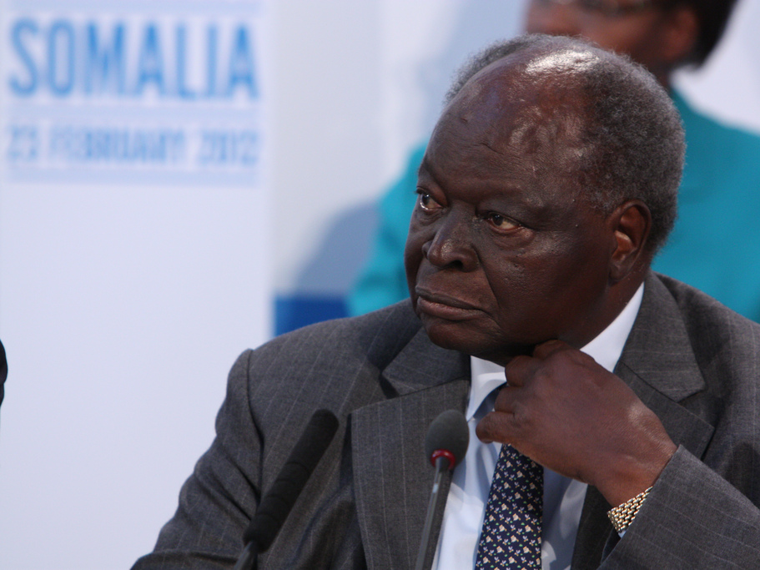
“…knowledge has become imperative for economic advancement. Indeed, a knowledge economy utilizes research findings in transformation of the thinking and the livelihoods of its people”
Mwai Kibaki, President of Kenya
UK FCO

Slide 4
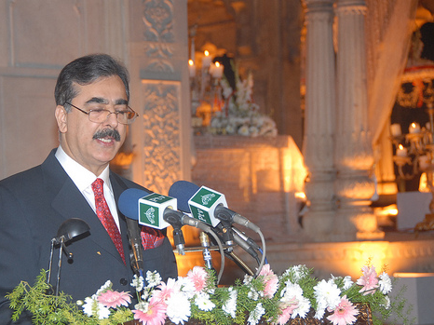
“…the ability of any country to achieve and maintain a decent standard of living is dependent on the extent to which it can harness science and technology for development” Syed Yousuf Raza Gilani, Prime Minister of Pakistan
Salmaan Taseer

Slide 5
On average, does investing funds in research lead to greater development impacts than investing the same amount of funds in alternative development interventions?

Slide 6
Economic growth
Evidence-informed policy
New products & technologies
Human capital

Slide 7
Theory of change (simplistic)
‘Supply’ of research
Economic growth
Human capital
Poverty reduction & improved quality of life
Products & technologies
‘Demand’ for research outputs
Evidence-informed policy/ practice

Slide 8
Economic Growth

Slide 9
“Inspired by the recent success of the Asian Tigers, We, the African governments, resolve to adopt a strategy that uses strategic investments in science and technology to accelerate Africa’s development into a developed knowledge-based society within one generation.”
Governments of Ethiopia, Mozambique, Rwanda, Senegal, and Uganda

Slide 10
Technology transfer
“Without a well-funded, high quality research system, it is unlikely that a technology transfer programme will make any significant contribution to economic development.”
Heher A.D. 2005

Slide 11
Absorptive capacity is critical

Slide 12
HUMAN CAPITAL

Slide 14
Capacity building?

Slide 15
PRO-POOR PRODUCTS AND TECHNOLOGIES

Slide 18
Evidence-informed policy and programmes

Slide 19
What works?

Slide 20
Understanding the world around us

Slide 21
There is no one ‘gold standard’ research approach

Slide 22
Supply

Slide 23
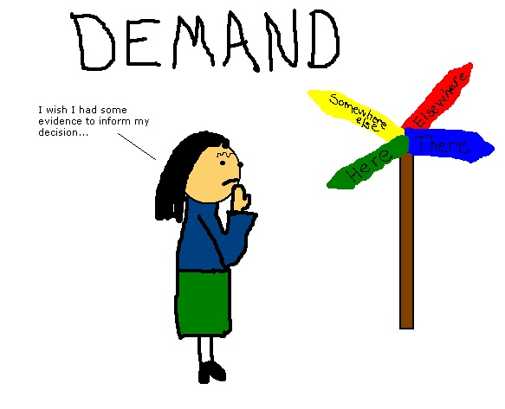
Demand/Usage

Slide 24
Conclusions
Little evidence that public investment in research is a significant driver of economic growth in low income countries
Investment in some forms of research capacity building can increase human capital - investment in skills to use research even more important
Pro-poor products and technologies can have transformational effects – provided they are actually used!
Evidence can inform policy and practice and thereby improve outcomes – but there remains low absorptive capacity

Slide 25
Thanks for listening!
Read the full paper: http://bit.ly/YRXqzB
Me on twitter: @kirstyevidence
My blog: http://kirstyevidence.wordpress.com/
Evidence into Action team on twitter: @DFID_evidence

